Slide 1
E-commerce

Slide 2
Electronic Commerce
E-commerce (electronic commerce) is the buying and selling of goods and services, or the transmitting of funds or data, over an electronic network, primarily the internet. These business transactions occur either as business-to-business (B2B), business-to-consumer (B2C), consumer-to-consumer or consumer-to-business.
Amazon market place
Ebay
Daraz

Slide 3
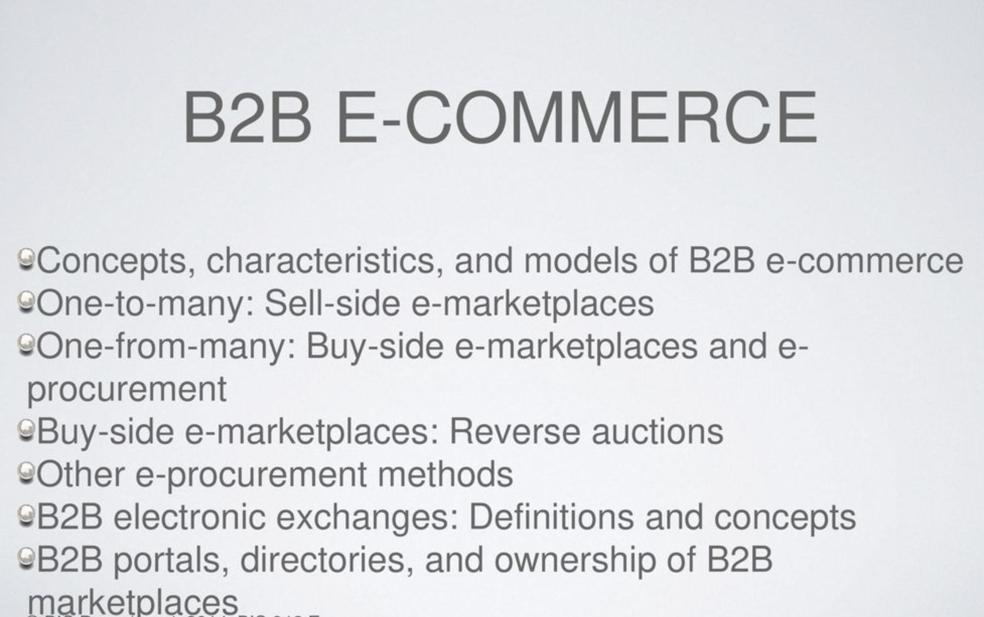
e-commerce - B2B

Slide 4
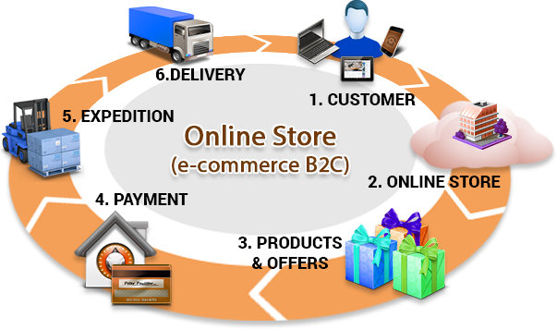
Topology of e-commerce - B2C

Slide 5
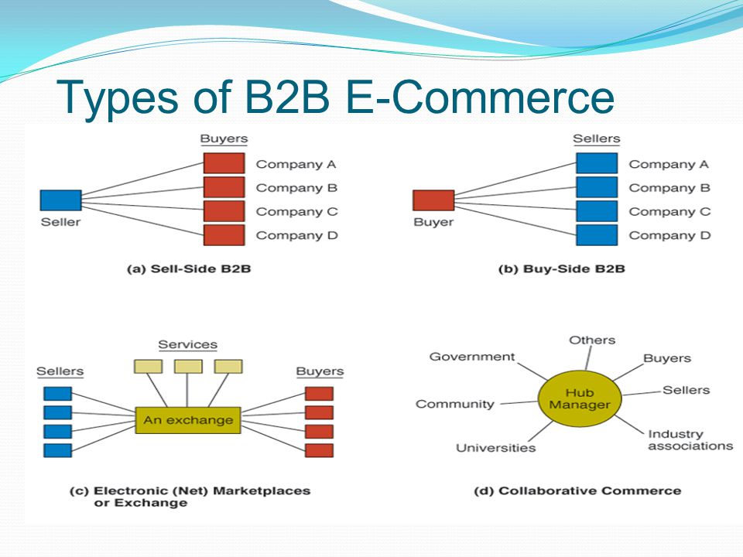

Slide 6
E-Commerce
B2C – Business to consumer
B2B – Business to business
C2B – Consumer to business
C2C – Consumer to consumer
D2C – Direct to consumer

Slide 7
B2G
B2G stands for Business-to-government, implying the relationship between a business to government agencies and government institutions. B2G is defined as a sales model when companies sell products, services and information to governments or government agencies (such as federal, state, or local agencies).
It should be noted that the B2G ecommerce model has the same definition as B2A (business-to-administration). Both the abbreviations refer to the enterprise specializing in distributing products and services to the state.

Slide 8
How Does B2G Work?
Unlike other sales models, the B2G ecommerce model is complex and requires strict compliance with business laws and conditions due to government agencies’ supervision and intervention.
In most cases, the state agencies will prepare pre-negotiated contracts, put out tenders, and ask businesses to participate in bidding.
Businesses that meet the government’s strict requirements will now calculate the fee and make the project’s pricing submission. Then, the government will review and select the most suitable enterprise and decide to sign a B2G contract with them.

Slide 9
Prospects of e commerce in Nepal
E commerce is a huge industry. It had a global estimated sales of over 3.5 trillion dollars last year alone. The staggering data indicates the inclination of worldwide commerce towards e-commerce. Considering the commercial growth and the consumer market, India and China are regarded as the forefront leaders of the e-commerce industry. Their economic growth and consumer market have enabled individual traders and commercial enterprises to trade through the digital medium. Meaning, the gap between consumers and businesses has narrowed down in India and China to a great extent. As for a smaller economy like Nepal, local businesses can benefit by tapping into a large number of the potential market, and business opportunities they create. Also, considering consumer and cultural similarities, Nepali companies can implement similar e-commerce strategies that best fit the company’s product and services.
This means, there are lots of e-commerce opportunities in the Nepali market. Companies like Daraz and other e-commerce sites have already started bridging trade gaps between the Nepali consumers and Chinese and Indian businesses. By introducing the Nepali consumers to a global market, it has opened doors for international trade. There are administrative complications, but overcoming them can help Nepali businesses compete on the global front.
Implementing digital trade can enable businesses to practice trade on a common platform and change the future of business.

Slide 10
prospects of e commerce in nepal
E commerce is a huge industry. It had a global estimated sales of over 3.5 trillion dollars last year alone. The staggering data indicates the inclination of worldwide commerce towards e-commerce. Considering the commercial growth and the consumer market, India and China are regarded as the forefront leaders of the e-commerce industry. Their economic growth and consumer market have enabled individual traders and commercial enterprises to trade through the digital medium. Meaning, the gap between consumers and businesses has narrowed down in India and China to a great extent. As for a smaller economy like Nepal, local businesses can benefit by tapping into a large number of the potential market, and business opportunities they create. Also, considering consumer and cultural similarities, Nepali companies can implement similar e-commerce strategies that best fit the company’s product and services.
This means, there are lots of e-commerce opportunities in the Nepali market. Companies like Daraz and other e-commerce sites have already started bridging trade gaps between the Nepali consumers and Chinese and Indian businesses. By introducing the Nepali consumers to a global market, it has opened doors for international trade. There are administrative complications, but overcoming them can help Nepali businesses compete on the global front.
Implementing digital trade can enable businesses to practice trade on a common platform and change the future of business.

Slide 11
prospects of e commerce in nepal
Personalized E commerce Experience
Businesses are trying their best to personalize the individual shopping experience. Taking trade online can help businesses achieve this particular goal by predicting consumer buying behavior and needs. Individual customers will get a peculiar experience based on their location, internet browsing history, past behavior, etc. For example, if you go to a retail shopping site and input “casual shirt”, the e-commerce platform in the site will list out recommendations based on your past internet browsing and online purchase pattern. Similarly, consumers also get brands with personalized brand value. Through relevant, and helpful content in e-commerce stores, customers are driven towards the right purchase.

Slide 12
prospects of e commerce in nepal
Multichannel Trade
With the presence of both digital and physical mediums for trade, customers are bound to use multi-channels during their purchase process. E commerce stores need to analyze the following to understand the buying behavior of customers:
- Customer’s purchasing process
- Preferred marketing channel of customers
- Purchase intent
Businesses are trying to understand consumer behavior and integrate both offline and online features into a single multi-channel shopping. Create purchase touch points for customers who browse online and purchase offline. Businesses can also implement the product booking strategy which allows customers to book products and purchase and pay from the store. Businesses need to sync their online and offline data to make streamline multi-channel shopping.

Slide 13
prospects of e commerce in nepal
B2B Trade
B2B e-commerce transaction is gradually rising. There is a growing trend of businesses buying software, products, and services for their own needs. SaaS and technology sectors are the two main industries that are encouraging B2B e-commerce. Similarly, food and garment producers are also opting for a digital medium to purchase raw materials to continue production. Therefore, B2B e-commerce stores need to ensure that they have features that facilitate large orders, billing and invoicing, volume-based discounts and reorder services.

Slide 14
prospects of e commerce in nepal
Shopping on Social Media
Social media shopping is gaining popularity among online consumers. As social sites improve their selling functions, these platforms have been ideal mediums of advertising and selling. Instagram, Facebook, Twitter, YouTube are some of the platforms that have introduced the “buy” button to make selling digitally more significant. In Nepal, businesses have limited social media marketing to only advertising. It is high time they took advantage of this trend to start multiplying social media followers and improve the customer base. Businesses can also introduce discount coupons in exchange for social media following or referral to engage consumer activity in their social media pages.

Slide 15
prospects of e commerce in nepal
AI Integration
Artificial Intelligence (AI) already plays an important role in e-commerce. AI chat bots and crawlers have been helping customers enhance their overall buying experience. Further, it helps businesses manage tasks that were typically assigned to humans. These AI assistants help enhance customer service by answering their queries, filing complaints, and displaying suitable product suggestions. These bots learn from customer conversation and behavior and evolve to better fit individual users.

Slide 16
prospects of e commerce in nepal
AI Integration
Artificial Intelligence (AI) already plays an important role in e-commerce. AI chat bots and crawlers have been helping customers enhance their overall buying experience. Further, it helps businesses manage tasks that were typically assigned to humans. These AI assistants help enhance customer service by answering their queries, filing complaints, and displaying suitable product suggestions. These bots learn from customer conversation and behavior and evolve to better fit individual users.

Slide 17
e commerce
Issues and challenges
Payment mechanisms
Order fulfillment
Payment gateways
Nepal e-Commerce landscape
issues and challenges

Slide 18
Issues and challenges
As the e-commerce industry grows, retailers are grappling with new technology and overcoming hurdles.
New technologies, like augmented reality and IoT (Internet of Things) commerce, have created even more challenges and considerations for e-commerce businesses.
E-commerce conversion margins are slim, so driving relevant traffic to your site is crucial.
The e-commerce explosion means competition is fierce, fulfilling orders can be overwhelming, and your return policy is critical.
The e-commerce industry has grown exponentially, with total e-commerce sales expected to reach $1.065 trillion by 2023. As an e-commerce business owner, you have unique challenges compared to brick-and-mortar shop owners. E-commerce businesses have unique rules and regulations to follow, and cybersecurity is a top priority to ensure all data stored online is protected.

Slide 19
Issues and challenges
Cybersecurity
Competition
Order fulfillment
Customer experience
Quality website traffic and visitor conversion
Visibility
Return and refund policies
Finding the right market
Making and increasing sales
Borderless e-commerce
Augmented reality
IoT commerce

Slide 20
Payment mechanisms
E-commerce sites use electronic payment, where electronic payment refers to paperless monetary transactions. Electronic payment has revolutionized the business processing by reducing the paperwork, transaction costs, and labor cost. Being user friendly and less time-consuming than manual processing, it helps business organization to expand its market reach/expansion. Listed below are some of the modes of electronic payments −
Credit Card
Debit Card
Smart Card
E-Money
Electronic Fund Transfer (EFT)

Slide 21
Payment mechanisms
Credit Card Payment Process
Step 1: Bank issues and activates a credit card to the customer on his/her request.
Step 2: The customer presents the credit card information to the merchant site or to the merchant from whom he/she wants to purchase a product/service.
Step 3: Merchant validates the customer's identity by asking for approval from the card brand company.
Step 4: Card brand company authenticates the credit card and pays the transaction by credit. Merchant keeps the sales slip.
Step 5: Merchant submits the sales slip to acquirer banks and gets the service charges paid to him/her.
Step 6: Acquirer bank requests the card brand company to clear the credit amount and gets the payment.
Step 7:Now the card brand company asks to clear the amount from the issuer bank and the amount gets transferred to the card brand company.

Slide 22
Order fulfillment
Order fulfillment is the process of storing inventory, picking and packing products, and shipping online orders to customers.
This process can be completed in-house by an ecommerce company or outsourced to a third-party logistics (3PL) provider.
Ecommerce order fulfillment applies to both business-to-business (B2B) orders — where large quantities of product are shipped to big-box retailers — as well as business-to-consumer (B2C) orders that are shipped directly to a single shopper’s home.
For B2C orders, the end consumer may place the order on the merchant’s website or through an online marketplace.
After the customer completes their purchase, the fulfillment process begins.

Slide 23
Order fulfillment
Understanding The Order Fulfillment Process
Receiving
Inventory storage
Order processing
Shipping
Returns processing
Order Fulfilment Strategy
Location is everything
Technology integrations
Free 2-day shipping

Slide 24
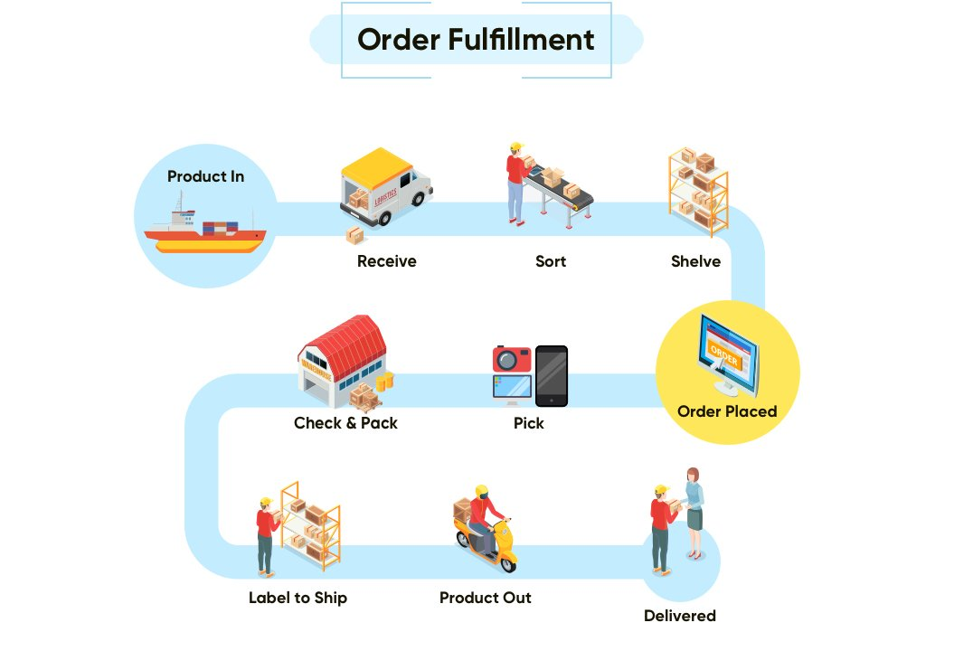

Slide 25
E-Commerce Payment Gateway
Payment Gateway is an online payment processing technology which helps businesses to accept credit cards and electronic checks. In other words, payment gateways are “Manin-the-middle” which are located between e-commerce platforms and clients.
A payment gateway allows you to −
Make and take payments quickly and easily.
Keep your customer's data (information) and money secure.
Gain trust of your customers, so they are willing to hand over their money.
Most Popular Payment Gateway Providers
PAYPAL
Amazon Payments
Stripe
Authorize Net
2Checkout
Digital Wallet (ESEWA, KHALTI)
ConnectIPS
PhonePay

Slide 26
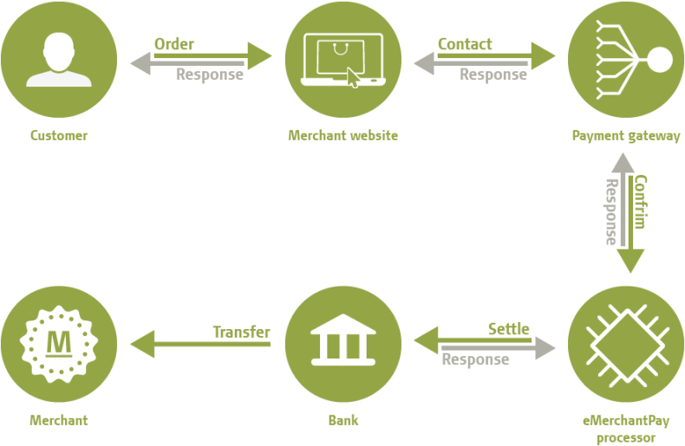
E-Commerce Payment Gateway

Slide 27
Nepal e-Commerce landscape
Currently organized for formal ecommerce has been observing significant improvement in the share of the market transactions in Nepal. Much of this has been attributed to the improvement in the digital literacy and comfort obtained by Nepalese during the COVID lockdown which has significantly propelled the progress of the ecommerce sector in Nepal.
Unorganized ecommerce has also been flourishing in Nepal especially due to the lack of methods to import consumer goods directly from foreign countries into Nepal. Informal/Social E-commerce through platforms such as Facebook and Instagram has led to the surge in the numbers of the informal ecommerce sector. This has been pointed out regularly as an important problem to be resolved by the proposed Ecommerce Bill in Nepal as this has been leading to negative externalities, loss of tax revenues and also unjust advantage of the informal sectors over the formal ones.
Some of the full fledged formal sectors of ecommerce sectors Nepal are listed below. The list also contains the major enterprises from the digital economy existing in Nepal as they also do function complementing and facilitating the ecommerce industry in Nepal.

Slide 28
Nepal e-Commerce landscape
Ecommerce
Business to Business: B2B eCommerce is in a nascent stage in Nepal.
Business to Customer: Daraz, Sastodeal, Foodmandu
Consumer to Consumer: Hamrobazar
Cross-border Ecommerce: Nepalis cannot yet order foreign ecommerce because foreign exchange is tightly regulated and only dollar cards can be used to make payment in foreign currency which is not widely accessible by all Nepalese. Some ecommerce like Sastodeal, maintain and deliver merchandise ordered from Flipkart India but they do not appear to be widely used in Nepal.
Online Advertising: Lone Tree Marketing, Marching Ants
Cloud Computing: Genese Solution
App Stores: n/a
Payment Services: Fonepay, Khalti, ConnectIPS
High Frequency Trading: n/a
Participative/Collaborative Networks: Wikipedia
Sharing Platforms: Innoventive
Content Networks: YouTube
Virtual Currencies: n/a

Slide 29
Nepal e-Commerce landscape
Logistics Service Providers (LSPs) in Nepal
Logistics is the cost incurred in the street. The World Bank, on average, estimates the logistics costs make up to 13% of GDP. The countries with least efficient infrastructures could see the cost as high as 25% of GDP. This estimate puts the cost of logistics in Nepal between USD 4 to 7.7 BN (14 -25% of GDP). Some tech enabled Delivery Service Providers (DSPs) in Nepal are:
Trucking
Short Haul: Upaya City Cargo, Dropmandu
Long Haul: n/a
Fulfillment
In House: Daraz, Sastodeal, Thulo Mall
Third Party: Aramex, TNT, DHL
Hyperlocal
B2B: Upaya City Cargo
B2C: Foodmandu, Pathao, Foodmario, Bhoj
On Demand: Nepxpress, Zapp, Puryau

Slide 30
Reference
https://www.bigcommerce.com/blog/ecommerce-fulfillment/#executive-summary
https://sushilparajuli.com/ecommerce-business-in-nepal/

